Slide 1
Contents
Data Link Layer Design Issues
Error Detection and Correction
Elementary Data Link Protocols
Example Data Link Protocols
Retransmission
Multiple Access

Slide 2
Detect errors and retransmit frame
Automatic Repeat reQuest (ARQ) often used when errors are common or must be corrected
E.g., WiFi, and TCP (later)
Rules at sender and receiver:
Receiver automatically acknowledges correct frames with an ACK
Sender automatically resends after a timeout, until an ACK is received

Slide 3
Detect errors and retransmit frame
Normal Operation (no loss)
Sender
Receiver
Frame
Timeout
Time
ACK

Slide 4
Detect errors and retransmit frame
Loss and Retransmission
Sender
Receiver
Frame
Timeout
Time
Frame
ACK

Slide 5
Detect errors and retransmit frame
Two non-trivial issues:
How long to set the timeout?
How to avoid accepting duplicate frames as new frames ?
Want performance in the common case and correctness always

Slide 6
Detect errors and retransmit frame
Timeout should be:
Not too big (link goes idle)
Not too small (spurious resend)
Fairly easy on a LAN
Clear worst case, little variation
Fairly difficult over the Internet
Much variation, no obvious bound
We’ll revisit this with TCP (later)

Slide 7
Detect errors and retransmit frame
Duplicates
Sender
Receiver
Frame
Timeout
Time
ACK
Frame
New frame?

Slide 8
Detect errors and retransmit frame
Duplicates
Sender
Receiver
Frame
Timeout
ACK
Time
Frame
New frame?
ACK

Slide 9
Detect errors and retransmit frame
Frames and ACKs must both carry sequence numbers for correctness
To distinguish the current frame from the next one, a single bit (two numbers) is sufficient
Called Stop-and-Wait

Slide 10
Stop and Wait
Normal Operation (no loss)
Sender
Receiver
Sender
Receiver
Frame
Frame 0
Timeout
ACK
Timeout
ACK 0
Time
Time
Frame
Frame 1
ACK
ACK 1

Slide 11
Stop and Wait
Duplicates (ACK Loss)
Sender
Receiver
Sender
Receiver
Frame
Frame 0
Timeout
ACK
Timeout
ACK 0
Time
Time
Frame
Frame 0
New frame?
ACK
missing
ACK
ACK 0

Slide 12
Stop and Wait
Duplicates (early timeout)
Sender
Receiver
Sender
Receiver
Frame
Frame 0
Timeout
ACK
Timeout
ACK 0
Time
Time
Frame
Frame 0
New frame?
Resend
ACK
ACK 0

Slide 13

Stop and Wait
It allows only a single frame to be outstanding from the sender:
Good for LAN, not efficient for high BD
Ex: R=1 Mbps, D = 50 ms
How many frames/sec? If R=10 Mbps?

Slide 14
Sliding Window
Generalization of stop-and-wait
Allows W frames to be outstanding
Can send W frames per RTT (=2D)
Various options for numbering frames/ACKs and handling loss
Will look at along with TCP (later)

Slide 15

Randomized Multiple Access
How do nodes share a single link?
Who sends when, e.g., in WiFI?
Explore with a simple model
Assume no-one is in charge; this is a distributed system

Slide 16
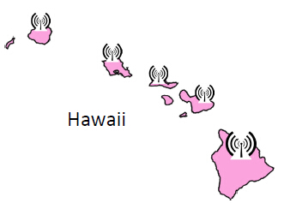
Aloha Network
(Additive Link On-line Hawaii system)
Seminal computer network connecting the Hawaiian islands in the late 1960s
When should nodes send?
A new protocol was devised by Norman Abramson …
Norman Abramson
(1932-)

Slide 17
Aloha Network
Simple idea:
Node just sends when it has traffic.
If there was a collision (no ACK received) then wait a random time and resend

Slide 18
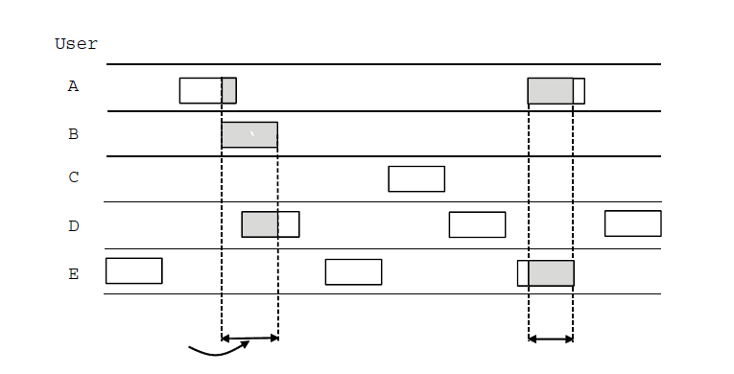
Aloha Protocol
In pure ALOHA, users transmit frames whenever they have data; users retry after a random time for collisions
Collision
Time
Collision

Slide 19
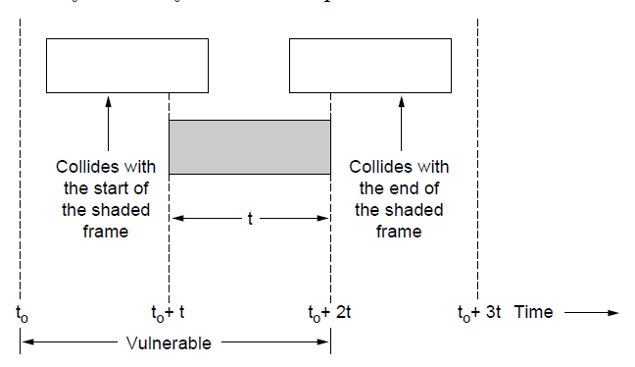
Aloha Protocol
Collisions happen when other users transmit during a vulnerable period that is twice the frame time
Synchronizing senders to slots can reduce collisions

Slide 20
Aloha Protocol
Simple, decentralized protocol that works well under low load!
Not efficient under high load
Analysis shows at most 18% efficiency
Improvement: divide time into slots (Slotted Aloha) and efficiency goes up to 36%

Slide 21
Classic Ethernet
ALOHA inspired Bob Metcalfe to invent Ethernet for LANs in 1973
Nodes share 10 Mbps coaxial cable
Hugely popular in 1980s, 1990s
Bob Metcalfe
(1947-)
Architecture of classic Ethernet.

Slide 22
Carrier Sense Multiple Access
CSMA improves on ALOHA by sensing the channel!
User doesn’t send if it senses someone else
So does this eliminate collisions?
Why or why not?
Variations on what to do if the channel is busy:
1-persistent (greedy) sends as soon as idle
Nonpersistent waits a random time then tries again
p-persistent sends with probability p when idle

Slide 23
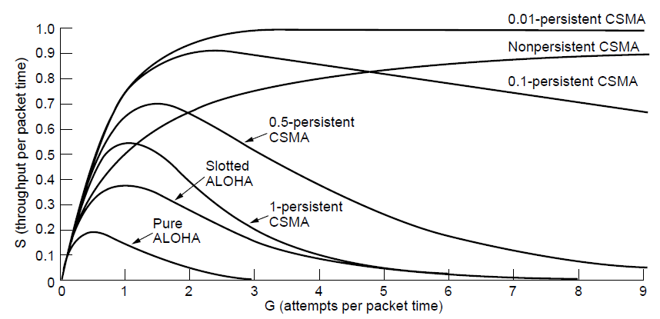
Carrier Sense Multiple Access
CSMA outperforms ALOHA, and being less persistent is better under high load

Slide 24
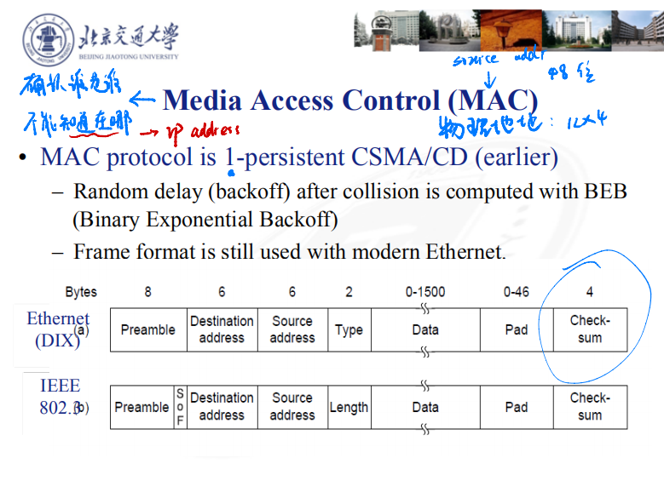
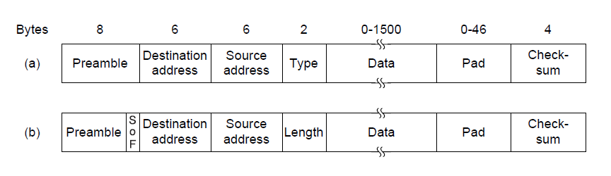
Media Access Control (MAC)
MAC protocol is 1-persistent CSMA/CD (earlier)
Random delay (backoff) after collision is computed with BEB (Binary Exponential Backoff)
Frame format is still used with modern Ethernet.
Ethernet
(DIX)
IEEE 802.3

Slide 25
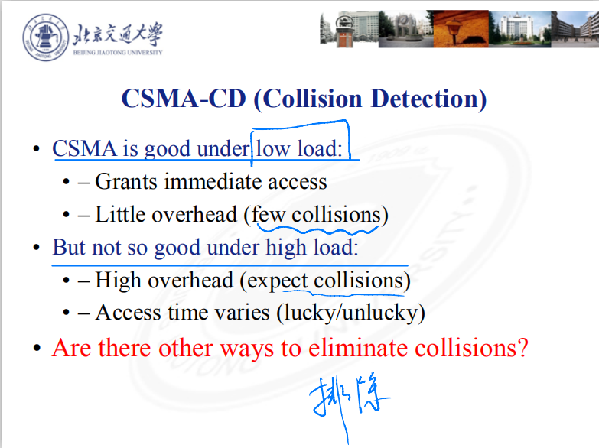

Slide 26
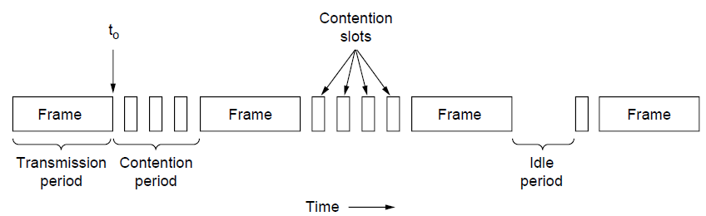
CSMA-CD (Collision Detection)
CSMA/CD improvement is to detect/abort collisions
Reduced contention times improve performance
Collision time is much shorter than frame time

Slide 27
CSMA-CD (Collision Detection)
Collision detection can take as long as 2τ

Slide 28
CSMA-CD (Collision Detection)
Most popular LAN of the 1980s, 1990s
10 Mbps over shared coaxial cable, with baseband signals
Multiple access with “1-persistent CSMA/CD with BEB (Binary Exponential Backoff Algorithm)”
Architecture of classic Ethernet.

Slide 29
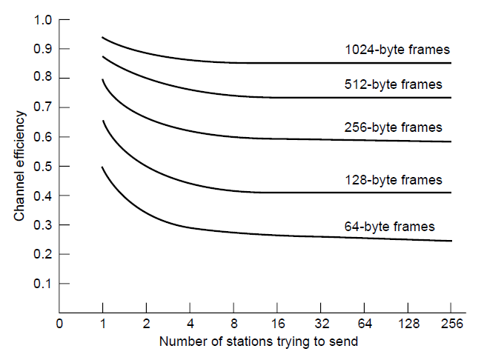
CSMA-CD Performance
Efficient for large frames, even with many senders
Degrades for small frames (and long LANs)
10 Mbps Ethernet,
64 byte min. frame

Slide 30
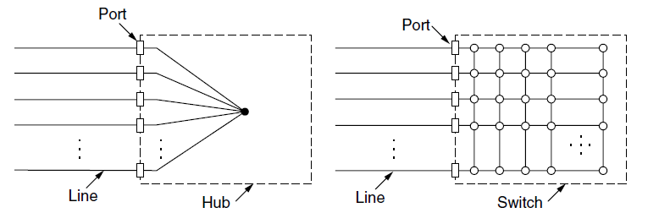
Switched/Fast Ethernet
Hubs wire all lines into a single CSMA/CD domain
Switches isolate each port to a separate domain
Much greater throughput for multiple ports
No need for CSMA/CD with full-duplex lines

Slide 31
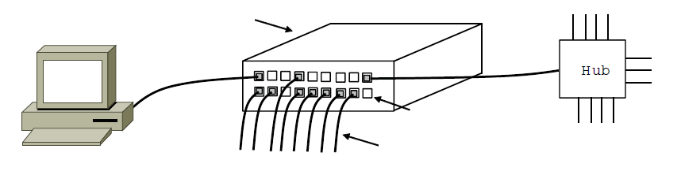
Switched/Fast Ethernet
Switches can be wired to computers, hubs and switches
Hubs concentrate traffic from computers
Switch
Hub
Switch ports
Twisted pair

Slide 32
CSMA-CD (Collision Detection)
CSMA is good under low load:
– Grants immediate access
– Little overhead (few collisions)
But not so good under high load:
– High overhead (expect collisions)
– Access time varies (lucky/unlucky)
Are there other ways to eliminate collisions?

Slide 33
Turn-Taking Multiple Access Protocols
They define an order in which nodes get a chance to send
– Or pass, if no traffic at present
We just need some ordering …
– E.g., Token Ring ?
– E.g., node addresses

Slide 34
Token Ring
Arrange nodes in a ring; token rotates “permission to send” to each node in turn
Token ring.

Slide 35
Turn-Taking Multiple Access Protocols
Fixed overhead with no collisions
More efficient under load
Regular chance to send with no unlucky nodes
Predictable service, easily extended to guaranteed quality of service
Complexity
More things that can go wrong than random access protocols! E.g., what if the token is lost?
Higher overhead at low load

Slide 36
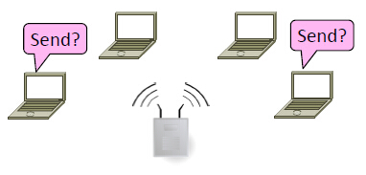
Wireless Multiple Access
How do wireless nodes share a single link? (Yes, this is WiFi!)
Build on our simple, wired model

Slide 37

Wireless Multiple Access
Wireless is more complicated than the wired case (Surprise!)
Nodes may have different areas of coverage – doesn’t fit Carrier Sense ?
Nodes can’t hear while sending – can’t Collision Detect ?

Slide 38
Wireless Multiple Access
Wireless has complications compared to wired.
Nodes may have different coverage regions
Leads to hidden and exposed terminals
Nodes can’t detect collisions, i.e., sense while sending
Makes collisions expensive and to be avoided

Slide 39
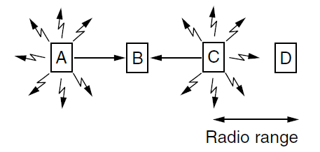
Wireless Multiple Access
Hidden terminals are senders that cannot sense each other but nonetheless collide at intended receiver
Want to prevent; loss of efficiency
A and C are hidden terminals when sending to B

Slide 40
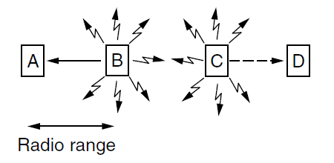
Wireless Multiple Access
Exposed terminals are senders who can sense each other but still transmit safely (to different receivers)
Desirably concurrency; improves performance
B → A and C → D are exposed terminals

Slide 41
Multiple Access with Collision Avoidance
MACA uses a short handshake instead of CSMA (Karn, 1990)
802.11 uses a refinement of MACA (later)
Protocol rules:
A sender node transmits a RTS (Request-To-Send, with frame length)
The receiver replies with a CTS (Clear-To-Send, with frame length)
Sender transmits the frame while nodes hearing the CTS stay silent

Slide 42
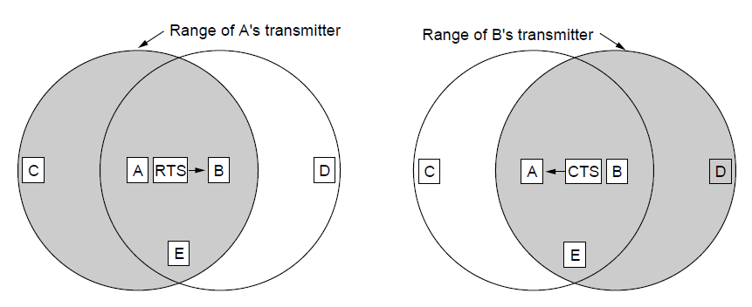
Multiple Access with Collision Avoidance
MACA protocol grants access for A to send to B:
A sends RTS to B [left]; B replies with CTS [right]
A can send with exposed but no hidden terminals

Slide 43
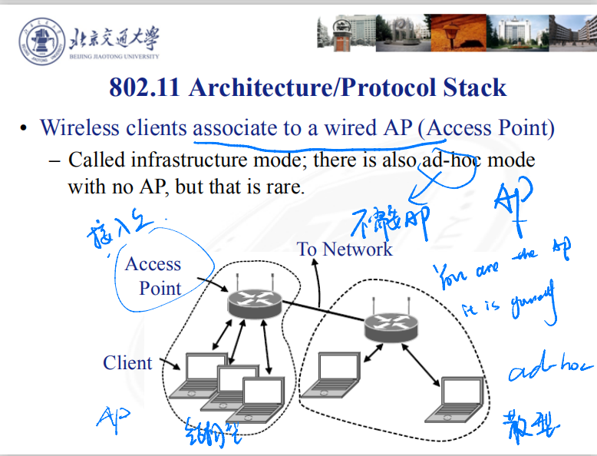
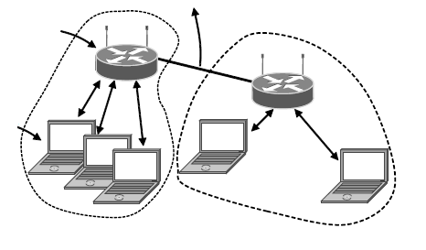
802.11 Architecture/Protocol Stack
Wireless clients associate to a wired AP (Access Point)
Called infrastructure mode; there is also ad-hoc mode with no AP, but that is rare.
To Network
Access Point
Client

Slide 44
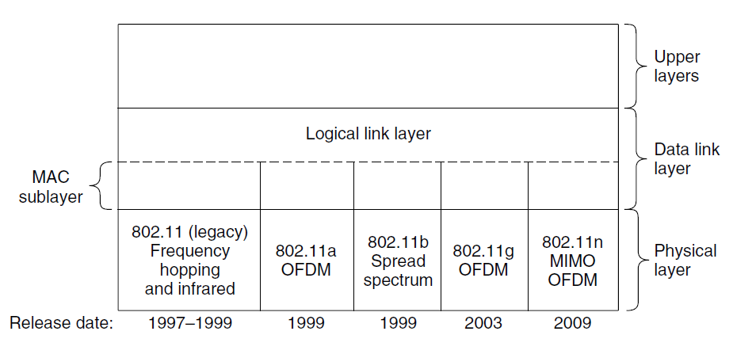
802.11 Architecture/Protocol Stack
MAC is used across different physical layers

